Slide 1

Space Vision 2018
November 1st-4th
San Diego, California

Slide 2

Build Space Better
Through collaboration we can achieve greater heights, improve on past accomplishments, and shape the future of space exploration.
Hosted by UCSD SEDS
Well known as the Best University Rocketry Organization in the US

Slide 3
Why are we going?
Network and connect with professionals in the aerospace industry
By attending Space Vision 2018: Build Space Better, we hope to bring back:
An immense amount of connections to further our knowledge in rocketry and better organizational management
Greater our knowledge in the importance of community outreach using rocketry (which is a very exciting gateway for students to joining STEM fields)
Obtain ideas on how to engage the community more with rocket launches, workshops etc.
Meet the majority of other SEDS members around the country and make connections
Learn how the top rocket engineering teams in the country manage and innovate

Slide 4
Budget
$85 Entrance to the Conference
Round Trip Flight for $430.00
Room for 3 nights is $100 per person
-$65 From SAFC*
Will attempt to reimbuse $2-300 per person from SEDS fund over the year
16 students coming
TOTAL
$615 up front
-$65 reimbursement
$548 per member
Overall club funding is ongoing, but it is expected that the funding will not support our operational costs and Space Vision reimbursement.

Slide 5
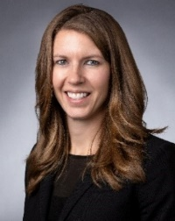
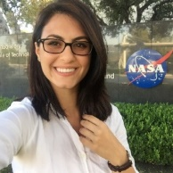
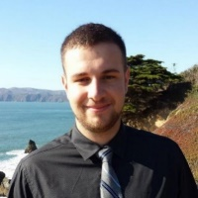
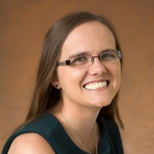
What goes on?
There are various workshops throughout regarding:
Liquid Propulsion Design
How to run an Engineering Organization
Community Engagement
How to Network as a 21st Century Engineer
Danielle Richey
Advanced Programs - Lockheed Martin Space
Diana Alsindy
Propulsion Engineer - Virgin Orbit
Kyle Adriany
Chief Technology Officer - Additive Rocket Corporation (ARC)
Keri Bean
Mission Operations Engineer - NASA Jet Propulsion Laboratory

